Slide 1
Classification of imbalanced dataset
16th March 2020

Slide 2
Contents
Introduction
Metrics
Techniques
Code Demo

Slide 3
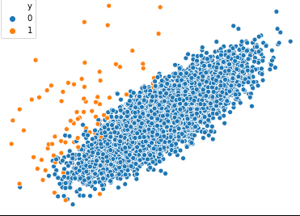
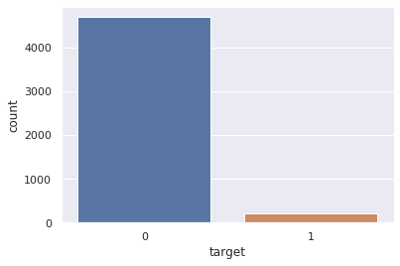
Introduction
Imbalanced classification are those classification tasks where the distribution of examples across the classes is not equal.
Examples: Spam/Ham classification, Credit card fraud detection, Cancer prediction etc.
Majority class - More than half of the examples belong to this class, often the negative or normal case.
Minority Class - Less than half of the examples belong to this class, often the positive or abnormal case

Slide 4
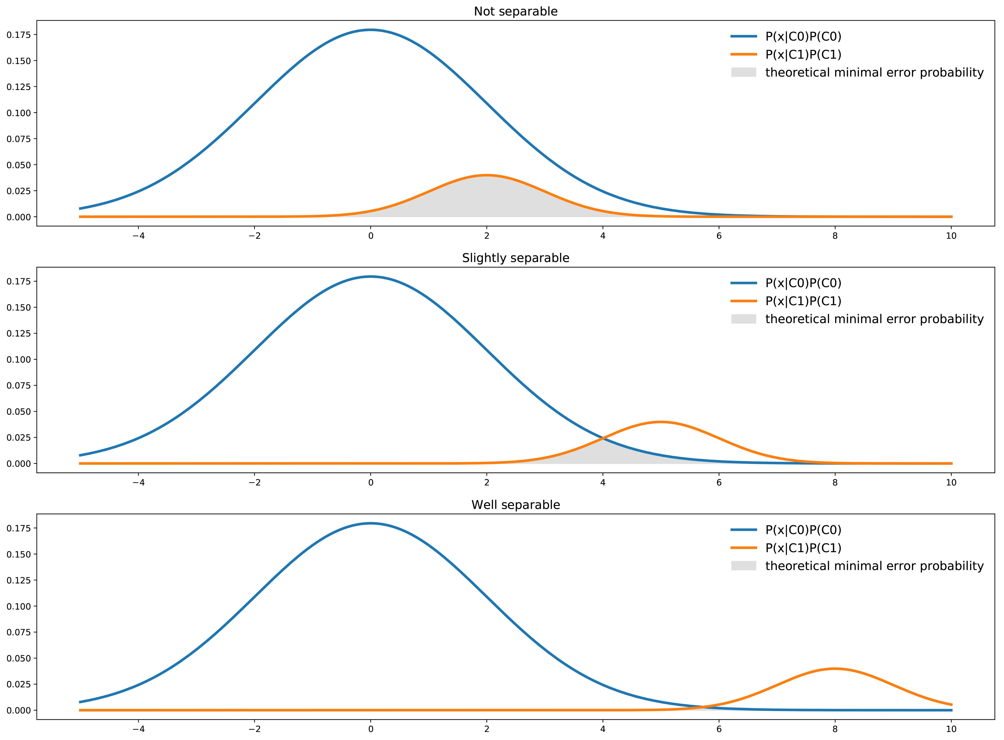
Class separatibility
not all datasets are affected equally by class imbalance
If there's a clear separation in the data, class imbalance doesn't impede on the model's ability to learn effectively
datasets that are inherently more difficult to learn from see an amplification in the learning challenge when a class imbalance is introduced
Image Credit

Slide 5
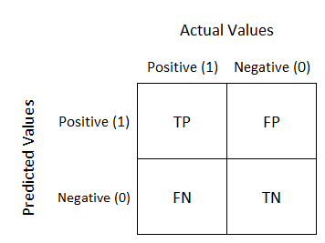
Metrics
Accuracy = (TP + TN) / (TP + FP + FN + TN) – misleading
Precision = TP / (TP + FP) – how trustable is the model prediction
Recall = TP / (TP + FN) – ability of the model to detect the class
F1 score = 2 (Precision x Recall) / (Precision + Recall)
High recall & high precision – good model
Low recall & high precision – model cannot detect the classes but it is highly trustable when it does
High recall & low precision – model can detect the classes but includes points of other classes in it
Low recall & low precision – poor model
Image Credit

Slide 6
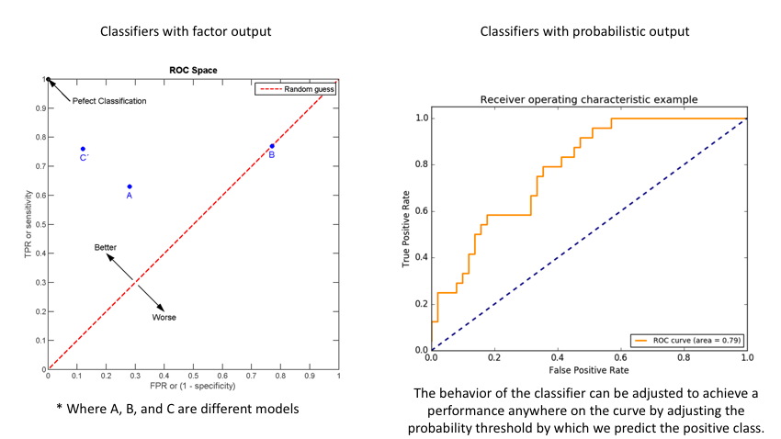
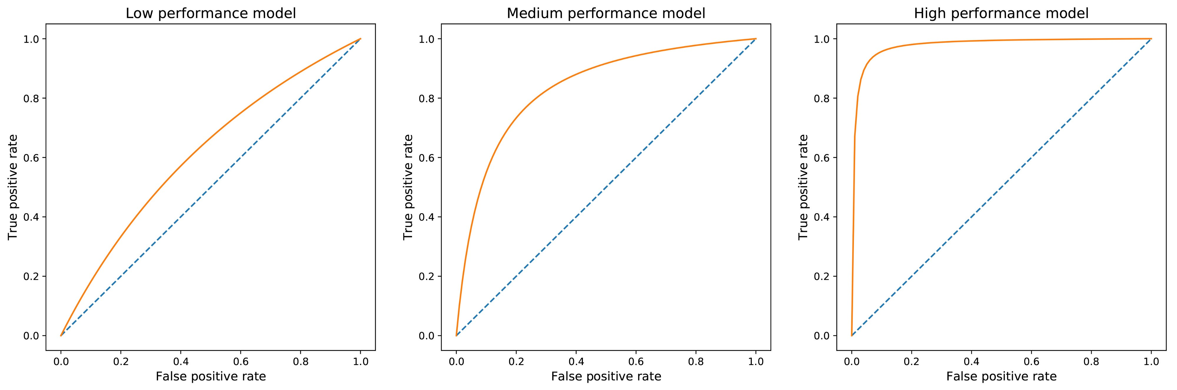
ROC and AUROC
TPR = TP / (TP + FN)
FPR = FP / (FP + TN)
AU-ROC = 0.5 – worst case
AU-ROC = 1 – best case
ROC Intuition -
Image Credit
http://www.navan.name/roc/
Image Credit

Slide 7

Techniques - Class weight
One of the simplest ways to address the class imbalance is to simply provide a weight for each class which places more emphasis on the minority classes such that the end result is a classifier which can learn equally from all classes
If ‘balanced’
- weights = n_samples / (n_classes * np.bincount(y))
- uses the values of y to automatically adjust weights inversely proportional to class frequencies in the input data
CrossEntropy = −ylog(p) − (1−y)log(1−p)
CrossEntropy = −w1*ylog(p) − w2*(1−y)log(1−p)

Slide 8
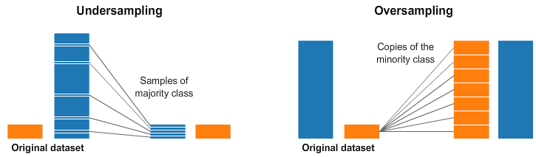
OVER sampling
Random Over Sampler - The most naive method of oversampling is to randomly sample the minority classes and simply duplicate the sampled observations.
Image Credit

Slide 9
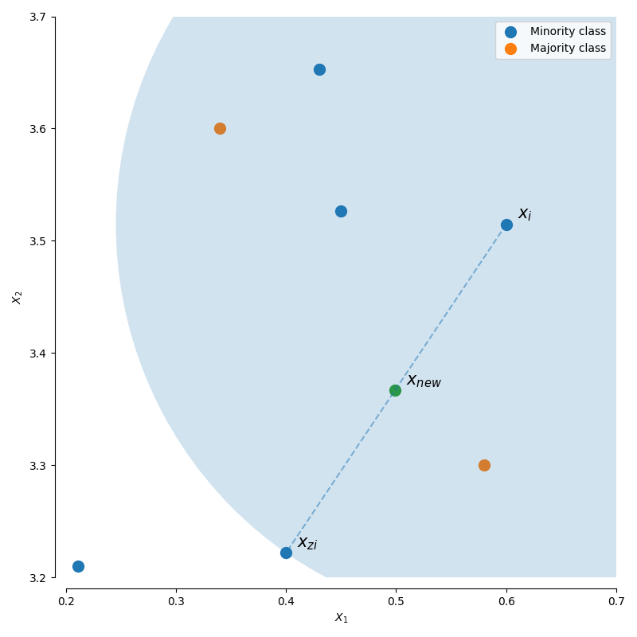

SMOTE
Synthetic Minority Oversampling Technique is a technique that generates new observations by interpolating between observations in the original dataset
For a given observation xi, a new (synthetic) observation is generated by interpolating between one of the k-nearest neighbors, xzi.
where λ is a random number in the range [0,1]. This interpolation will create a sample on the line between xi and xzi.
Image Credit

Slide 10
Smote - Variants
SMOTE: No selection rules, randomly sample all possible xi.
BorderlineSMOTE: Separates all possible xi into three classes using the k nearest neighbors of each point.
noise: all nearest-neighbors are from a different class than xi
danger: at least half of the nearest neighbors are of the same class as xi
safe: all nearest neighbors are from the same class as xi
SVMSMOTE: Uses an SVM classifier to identify the support vectors (samples close to the decision boundary) and samples xi from these points.

Slide 11
ADASYN
Adaptive Synthetic Sampling Approach for Imbalanced learning
Adaptive Synthetic (ADASYN) sampling works in a similar manner as SMOTE, however, the number of samples generated for a given xi is proportional to the number of nearby samples which do not belong to the same class as xi. Thus, ADASYN tends to focus solely on outliers when generating new synthetic training examples.
The key idea of ADASYN algorithm is to use a density distribution rˆi as a criterion to automatically decide the number of synthetic samples that need to be generated for each minority data example.
In SMOTE, equal number of synthetic samples are generated for each minority class

Slide 12
UNDER SAMPLING
Random Under Sampler - a naive implementation would be to simply sample the majority class at random until reaching a similar number of observations as the minority classes.
Image Credit

Slide 13
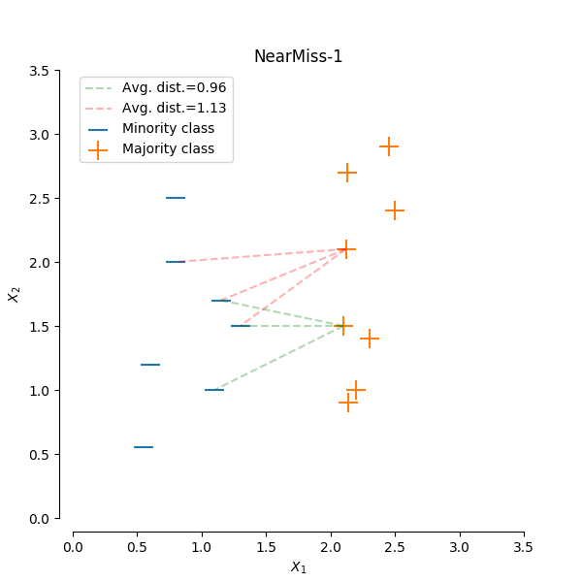
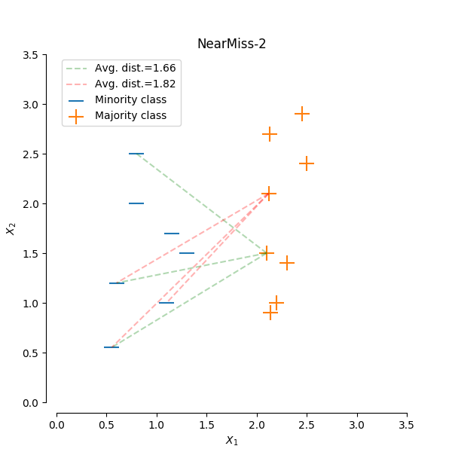
Near miss
NearMiss-1: Majority class examples with minimum average distance to three closest minority class examples.
NearMiss-2: Majority class examples with minimum average distance to three furthest minority class examples.
NearMiss-3: Majority class examples with minimum distance to each minority class example.
Image Credit

Slide 14
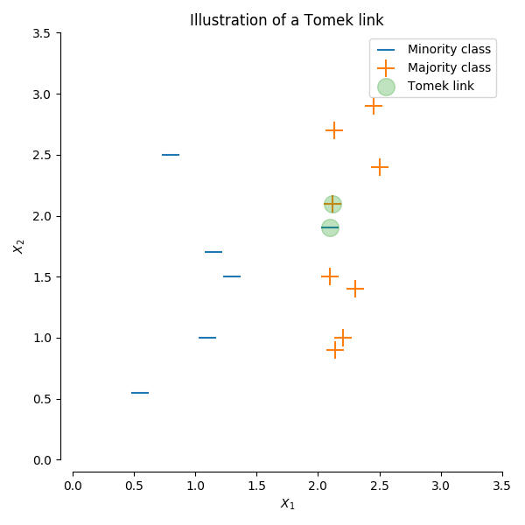
Tomek links
A Tomek’s link is defined as two observations of different classes (x and y) such that there is no example z for which:
d(x,z)<d(x,y) or d(y,z)<d(x,y)
where d() is the distance between the two samples.
In other words, a Tomek’s link exists if two observations of different classes are the nearest neighbors of each other.
Depending on the dataset, this technique won't actually achieve a balance among the classes - it will simply "clean" the dataset by removing some noisy observations, which may result in an easier classification problem.
Image Credit

Slide 15
Edited nearest neighbour
EditedNearestNeighbours applies a nearest-neighbors algorithm and “edit” the dataset by removing samples which do not agree “enough” with their neighboorhood.
for each instance a in the dataset, its three nearest neighbors are computed. If a is a majority class instance and is misclassified by its three nearest neighbors, then a is removed from the dataset. Alternatively, if a is a minority class instance and is misclassified by its three nearest neighbors, then the majority class instances among a’s neighbors are removed.

Slide 16
CODE DEMO
https://github.com/bismillahkani/imbalanced-learning/blob/master/Classification_of_imbalanced_dataset.ipynb

Slide 17
References
https://www.jeremyjordan.me/imbalanced-data/
https://towardsdatascience.com/handling-imbalanced-datasets-in-machine-learning-7a0e84220f28
https://imbalanced-learn.readthedocs.io/en/stable/api.html
SMOTE - https://arxiv.org/pdf/1106.1813.pdf
Borderline SMOTE - https://sci2s.ugr.es/keel/keel-dataset/pdfs/2005-Han-LNCS.pdf
ADASYN - https://sci2s.ugr.es/keel/pdf/algorithm/congreso/2008-He-ieee.pdf
Near Miss - https://www.site.uottawa.ca/~nat/Workshop2003/jzhang.pdf

Slide 18
Questions?
bismillahkani@gmail.com

